Slide 1
wSAST
Code review Tool of the future (Mostly because it is never finished)

Slide 2

Whoami?
Peter Winter-Smith (@peterwintrsmith on Twitter)
Most well known as Peter Wiener from Burp/Portswigger Labs
Previously: AppSec consultant (web, client, native) with code focus
Now: Offensive tool developer
One previous public project: Crystal Anti-Exploit Protection 2012 (source: https://github.com/peterwintersmith/crystalaep)

Slide 3

What the…
Code analysis platform with multiple language support
Provides code searching, graphing, dataflow and static SAST
Lowers code to an IL resembling simplified Java with some extensions to increase flexibility
Plugin architecture that allows anything in the IL format to be a “source” or “sink”
Designed to support real consultant needs rather than only dev teams (e.g. no compilation, partial source)
Designed for constrained platforms – single or multi-threaded parsing, analysis, scanning, and memory/time guardrails

Slide 4

Why the…
I’ve had an interest in parsing and code analysis for the past 10 years
First attempt in 2013 failed miserably – couldn’t even write a proper EBNF processor; read a few books on parsing and they were too complicated
Revisited them several years later with increased maturity and focus, found some better books, and second time around the subject made more sense
Made employment changes in 2020 for multiple reasons, one of which was to allow me to focus more on developing this tool
Goal is to produce a cheap, partially open source, community centered alternative to expensive/restricted SAST platforms, with some added extras to help in initial assessment phases

Slide 5
Technical Overview

Slide 6
Technical - High Level Design
Multiple major components, including:
Code Processors:
Context Analyzers:
Semantic Analyzers:
Symbolic Execution:
Static Evaluation
Parsers
Translators
WSIL
Knowledge
Scope
Local
Global
Type
Dataflow Engine

Slide 7
Analysis Phases – Code Processing
Multiple major components, including:
Code Processors:
Context Analyzers:
Semantic Analyzers:
Symbolic Execution:
Static Evaluation
Parsers
Translators
WSIL
Knowledge
Scope
Local
Global
Type
Dataflow Engine

Slide 8
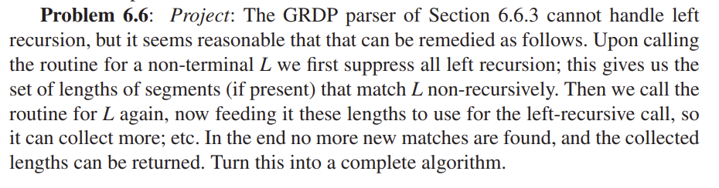

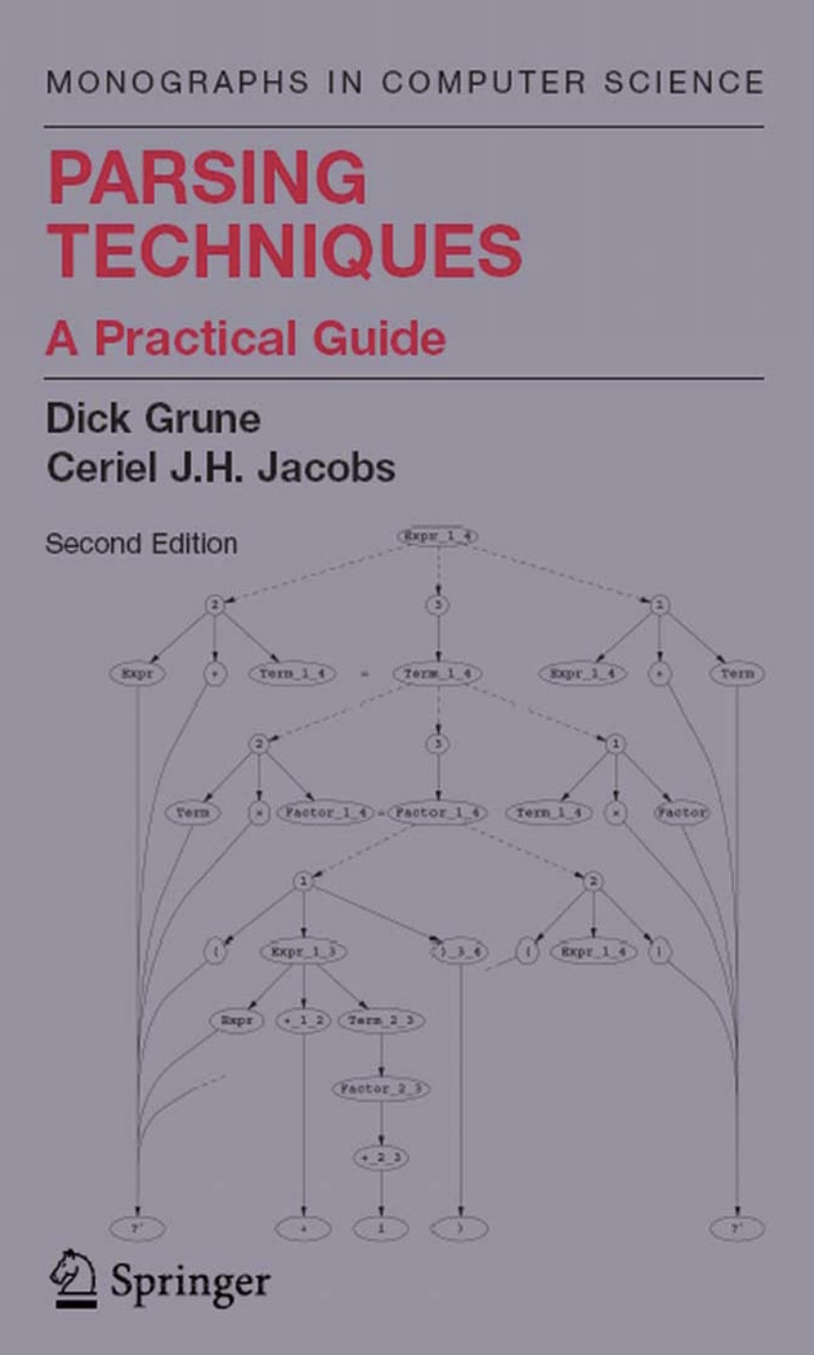
Parsers
Idea for wSAST born out of experimentation with parsers
Read numerous books on parsing, ended up writing own framework based on an idea in Grune book
The framework supports LL(*) parser generation – it works roughly like this:
EBNF grammar is processed into an AST and annotated with information on left recursion (which productions and rules are LR)
Code is generated to handle different rule types ((non-)terminals, optionals, repetitions, etc.)
For a given production all non-LR rules are matched, then the entire list of matches are fed into the LR rule matchers and these are added to the set of matches
This process recurs until all matches are exhausted at which point a complete set of possible parse trees have been found
Notes:
Indirect recursion needs to also be considered in the same way.
To make this process efficient various tricks are needed such as caching of intermediate results and disambiguation at as early a stage as possible.
Ultimately will only use my parser for Java; it would be better to use open source parsers for simplicity/maintenance and to keep the translators open source.

Slide 9
Translators
A parse tree must be converted into an intermediate language called WSIL which is understood by wSAST
WSIL is similar to Java, but with a few changes to support some concepts from C++/C# (see: WSIL.ebnf)
The parsers implement an ILanguageProvider interface and must invoke a callback to provide updates including the WSIL tree
A helper class is provided to help build WSIL trees and a validator to ensure they’re correctly formed
References to the original parse tree and associated source files can be stored within the tree; ambiguous parses can be recorded and resolved later if needed
Notes:
WSIL trees can also have arbitrary data attached which enables language-specific extensions; Java annotations are an example of this since WSIL does not support annotations.
Only function call ambiguities are currently resolved but WSIL will have to be extended in the future to handle a larger range of ambiguities such as those arising from parsing C++.

Slide 10
Analysis Phases – Context Analysis
Multiple major components, including:
Code Processors:
Context Analyzers:
Semantic Analyzers:
Symbolic Execution:
Static Evaluation
Parsers
Translators
WSIL
Knowledge
Scope
Local
Global
Type
Dataflow Engine

Slide 11
Knowledge Analyzer
The KnowledgeDB (KDB) is the authoritative database representing the entire codebase under analysis
WSIL trees are walked in a single phase by the Knowledge Analyzer using a recursive tree walk which builds the KDB in tandem
Elements of the KnowedgeDB (KDB) are CodeObjects and have types such as NAMESPACE, CLASS, METHOD, BLOCK, VARIABLE etc.
Each CodeObject has an associated path, WSIL node reference, scope information, and internally a search function to handle proper searching
The KDB exposes methods for code searching, accessing certain properties of code objects like type parameters and code block exits
Notes:
The KDB is currently entire in memory; it wouldn’t be hard to write out parts to disk based on access frequency allowing processing of larger projects.

Slide 12
Scope Analyzer
The Scope Analyzer walks a WSIL tree in a single pass attaching a UnitScope annotation to each associated CodeObject KDB entry
The UnitScope contains information such as:
The code unit to which the CodeObject belongs (often source file)
The resolved and unresolved imports
The namespaces visible to the CodeObject
A scope field that anchors the visibility of the object (in case of name conflicts)
The scope information is used by the KDB when performing searches, to ensure only visible CodeObjects are identified, as well as to clear variables that fall out of scope during analysis
Notes:
This is an essential part of semantic analysis because the same name can refer to many different things from different places within a codebase.

Slide 13
Analysis Phases – Semantic Analysis
Multiple major components, including:
Code Processors:
Context Analyzers:
Semantic Analyzers:
Symbolic Execution:
Static Evaluation
Parsers
Translators
WSIL
Knowledge
Scope
Local
Global
Type
Dataflow Engine

Slide 14
Type Analyzer
The Type Analyzer walks each tree in the entire codebase, annotating the WSIL tree nodes with type information
Whenever a well-known type (like a literal), or a defined type (like a variable) is used, the pass annotates the associated identifier or expression with the type as a string (e.g. “int4”, “boolean“, “MyClass”, “unresolved:String”)
Expressions are annotated by looking up type information known thus far in the KDB and propagating throughout the remainder of the expression
Other sources of type information such as method return values are also used and propagated
Generic types are specialised with usage and added to the KDB here
Notes:
Type information is currently stored only as a string, and an expression can only take one type. This is a bit of a shortcoming as it makes expressing things like type coercion more difficult.

Slide 15
Global CF Analyzer
The Global Control Flow Analyzer phase then processes all method calls, attempting to connect the WSIL “call” expression nodes to the tree elements for the methods they invoke
To do this a best fit approach is used - taking into consideration:
Parameter types and counts
Types and inheritance of instance methods
Types and inheritance of parameter types (for closer matching)
Variable parameter counts
Generic class/method type specializations
This wires up constructor calls too when a WSIL “new” call is encountered
Generic types encountered are also specialized with usage here
Notes:
Operator overloading is not supported by WSIL so care would need to be taken to recognize it in a source language and handle appropriately.

Slide 16
Global CF + Type Analyzer Phases
The global CF analysis and type analysis phases are interdependent and continue until no new information is obtained (no new control flow paths, no new type information propagated)
This is necessary because type information influences control flow (for example, if we learn that a local variable is a class instance, we can resolve methods on it if called)…
… and control flow influences type information because we can then propagate that method return types, etc.

Slide 17
Local Control Flow Analyzer
The Local Control Flow Analyzer represents the final phase of analysis; it annotates WSIL statement nodes with information representing how they influence control flow (e.g. if/else, switch, goto, try/catch)
This phase is a tree walk which descends statement blocks linking them together to form a graph over the WSIL tree
Each non-control-flow-altering statement is assigned a “basic block” or “throwable basic block” type and is linked to the statement following
Control flow influential statements (such as if/else) are linked to the block of “basic blocks” based on their separate statement blocks
The process tracks special statements (such as loop break/continue, throwable basic blocks) and wires them up when such statement types are encountered
Notes:
For example, a loop containing an if statement containing a break clause.
The loop entry is linked to the output of processing the loop body, the loop body passes back the entry point and exit points from the body block.
Processing the body block in turn returns the entry and exit points from the if statement.
Processing the if statement in turn returns the entry and exit points but also the deferred exit from the “break” clause.
Each processing phase connects each prior statement to the next, and each exit point to the first statement following, but when the loop is processed the deferred exit is wired up to the loop exit point.

Slide 18
Analysis Phases – Dataflow Analysis
Multiple major components, including:
Code Processors:
Context Analyzers:
Semantic Analyzers:
Symbolic Execution:
Static Evaluation
Parsers
Translators
WSIL
Knowledge
Scope
Local
Global
Type
Dataflow Engine

Slide 19
Entrypoint Analysis
Once the analysis phases are completed, before dataflow analysis can proceed it is necessary to find the set of all entrypoints into a codebase
This is usually a superset of all real entrypoints into a codebase due to missing code
Entrypoint analysis finds all functions and free code blocks with no callers (or preceding statements), recursively walking backwards from all methods eliminating candidates until a minimal set is identified
Recursive functions which have no single caller as an entrypoint are picked randomly as entrypoints

Slide 20
Dataflow Engine (1)
When all of the analysis phases are completed, it is possible to invoke the Dataflow Engine to simulate execution
The dataflow engine walks the local control flow graph from the set of entrypoints determined, including entering called functions and constructors
The engine switches class contexts (creating necessary this pointer, member variables, outer class variables) as needed when calling across class boundaries, and walks inheritance hierarchies as needed

Slide 21
Dataflow Engine (2)
For each “step” of “execution” any registered source or sink callbacks are invoked; these are passed all execution state information thus far, the node on which they’ve been invoked, all variables and their state information etc.
These can create new variables, set variables as traced, assign arbitrary data to variables
Dataflow state and variables are cloned whenever updated, and merged at the convergence of control flow points to prevent incorrect findings
Notes:
Stepping from one basic block to the next clones the state and updates the path, but more expensive types such as variables, sink matches, etc. are only copied when updated.

Slide 22
Sources + Sinks + Subscribers
These are registered with the engine and can implement custom checks
Sources are attached to the execution state, and sinks are attached to variables
Sources and sinks can record variables, create new ones, set traced status, validate previously encountered sinks, examine code path and WSIL tree context, and even attach arbitrary data to variables
Whenever a source reaches a matching sink the sink can choose to create a “source-to-sink-match” object and pass it to any registered subscribers
Subscribers report findings and are provided with source, sink and any other context needed such as recorded variables

Slide 23
Functionality Overview

Slide 24
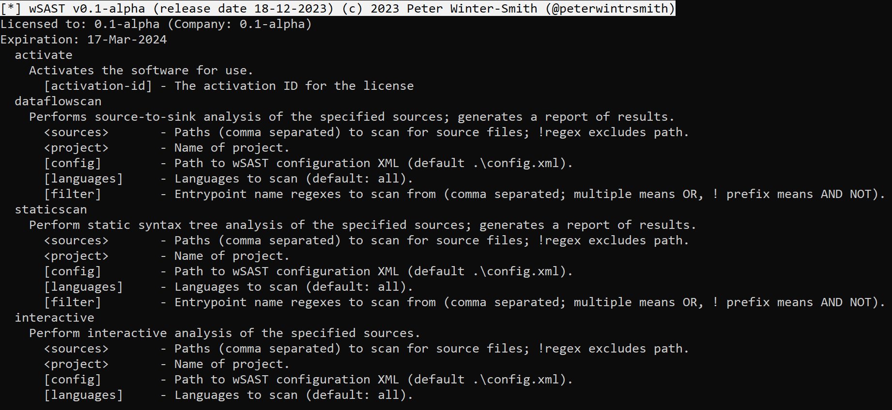
Usage – High Level
Command-line driven dataflow or static scans
Interactive mode to allow REPL-style search, graphing, iterative scans

Slide 25
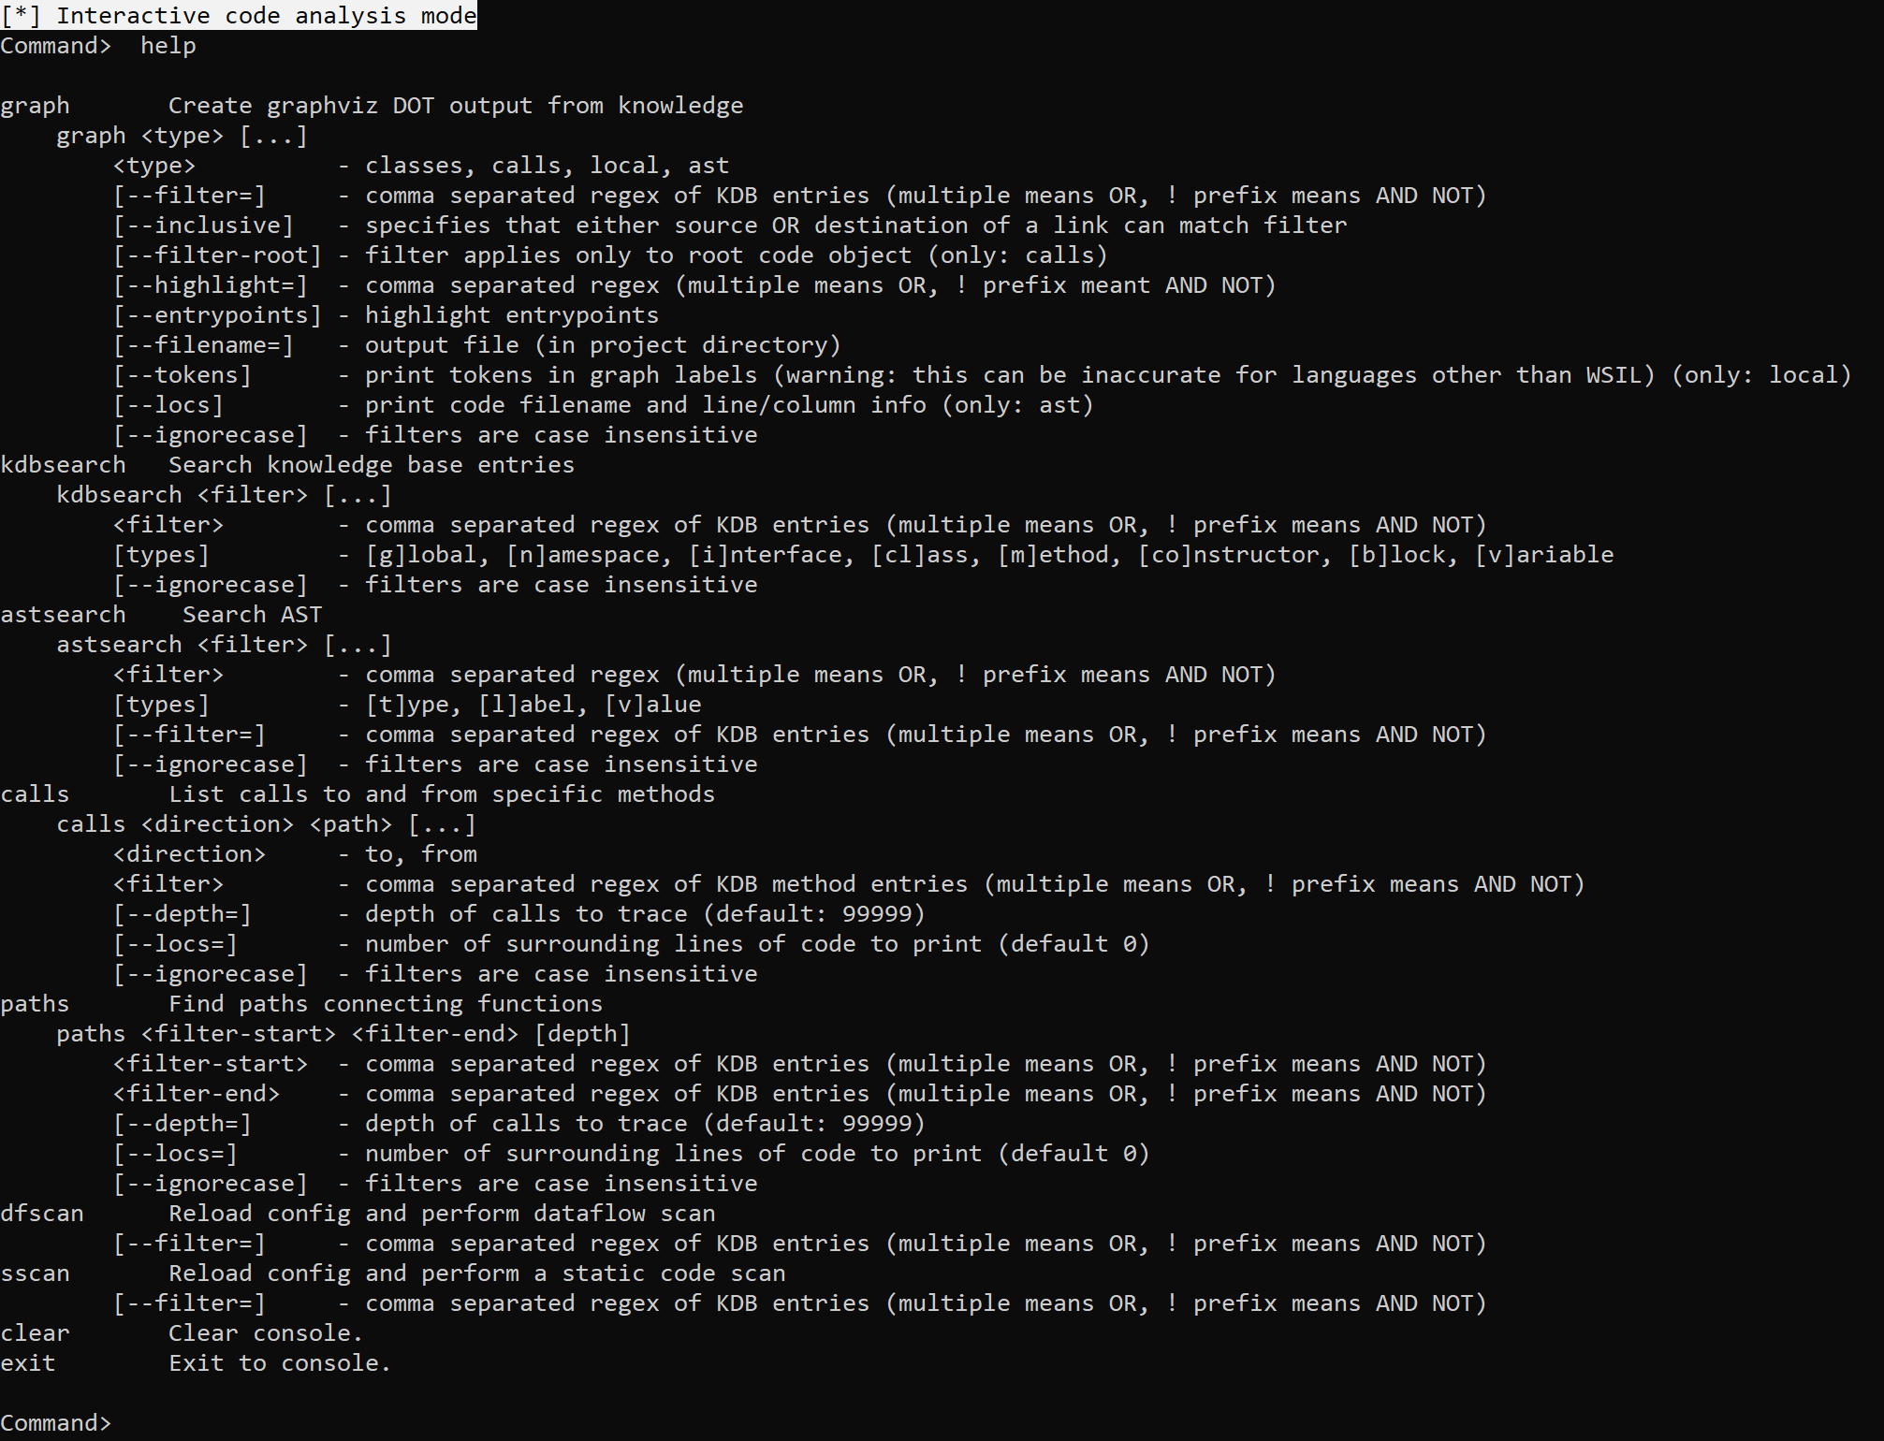
Usage – Interactive
Graph class relationships, calls, local control flow and WSIL AST
Search KnowledgeDB or AST to locate specific methods, classes, variables.
List calls to and from particular methods, classes
Find paths between methods
Search is regex based and inclusive or exclusive

Slide 26
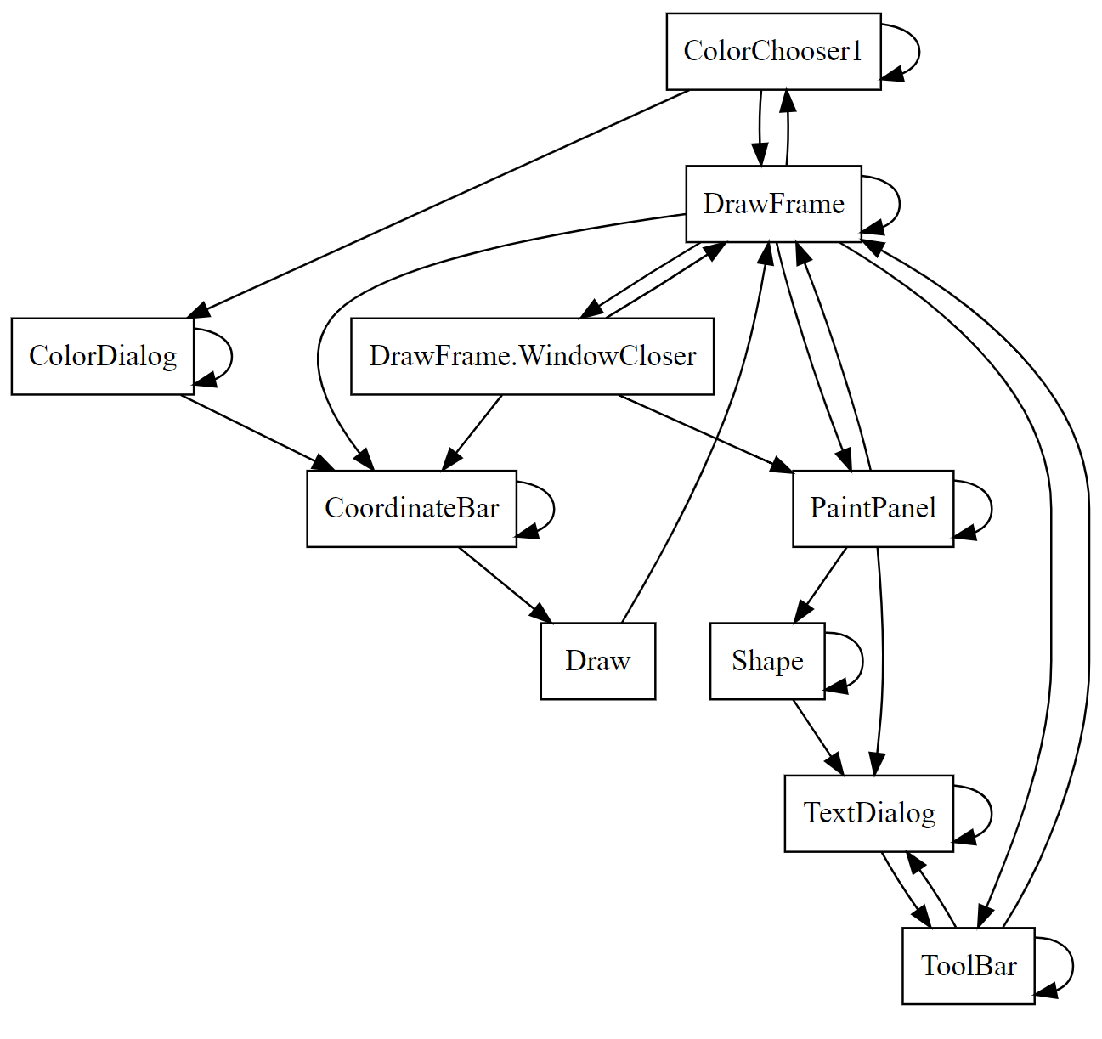
Example – Graphing Classes
Relationships between classes can be easily observed

Slide 27
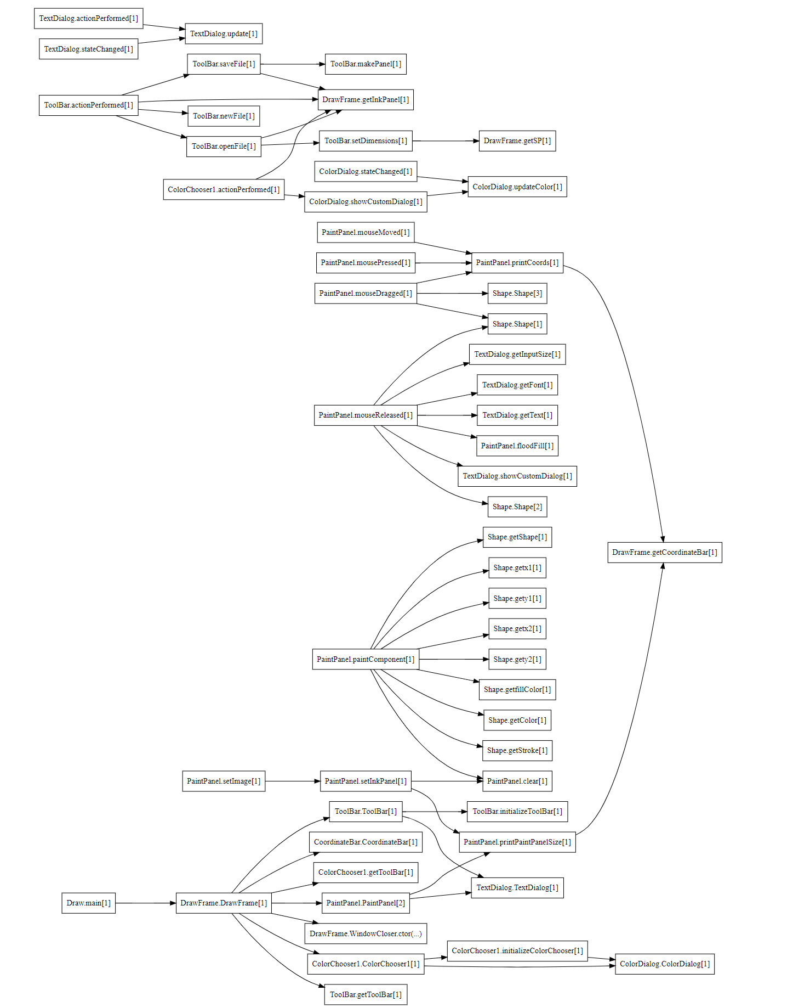
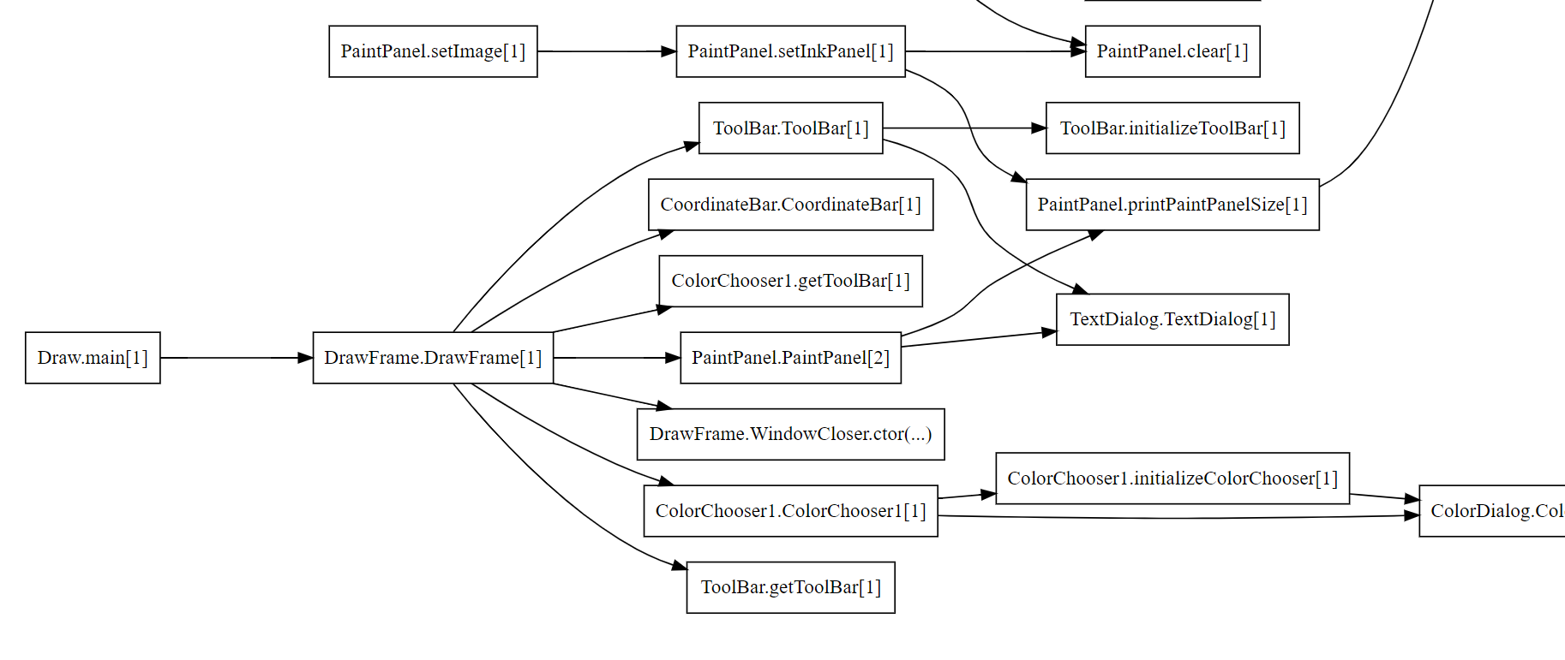
Example – Graphing Calls
Call flows can be graphed, filtered as required and highlighted

Slide 28
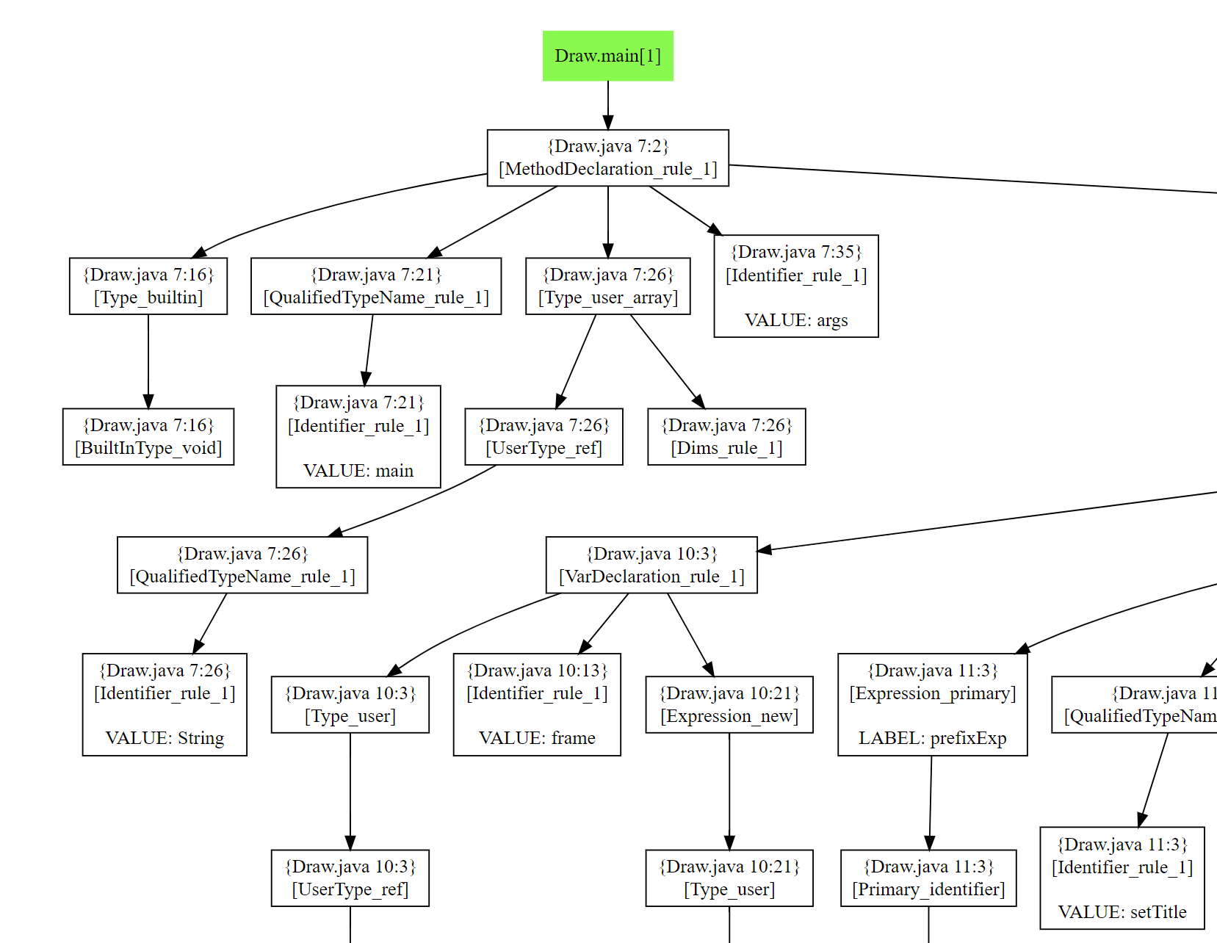
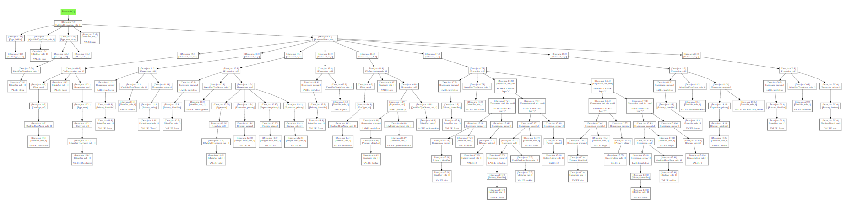
Example – Graphing AST
WSIL AST graph is useful for debugging if writing a language plugin

Slide 29
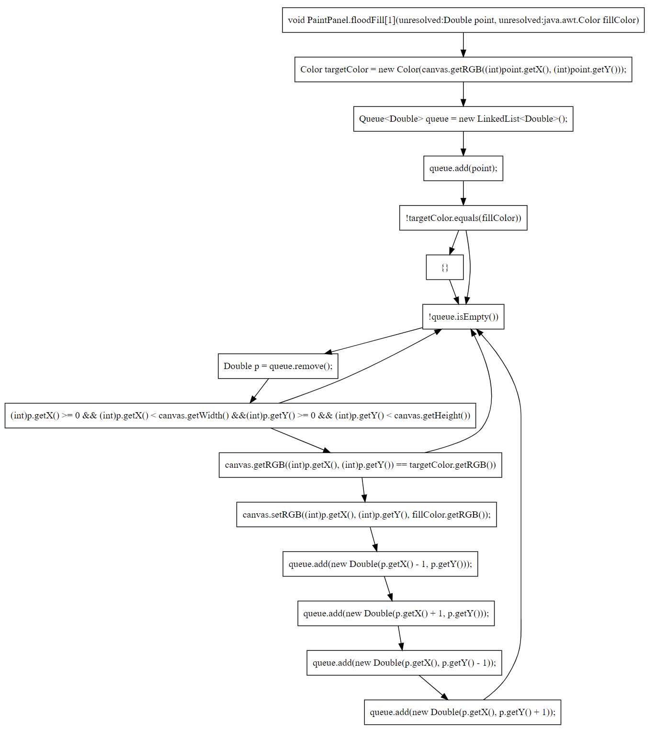
Graphing - Local
Local control flow graph is not very useful in practice but fun to examine
Likely to be useful if an IDE plugin is ever created

Slide 30
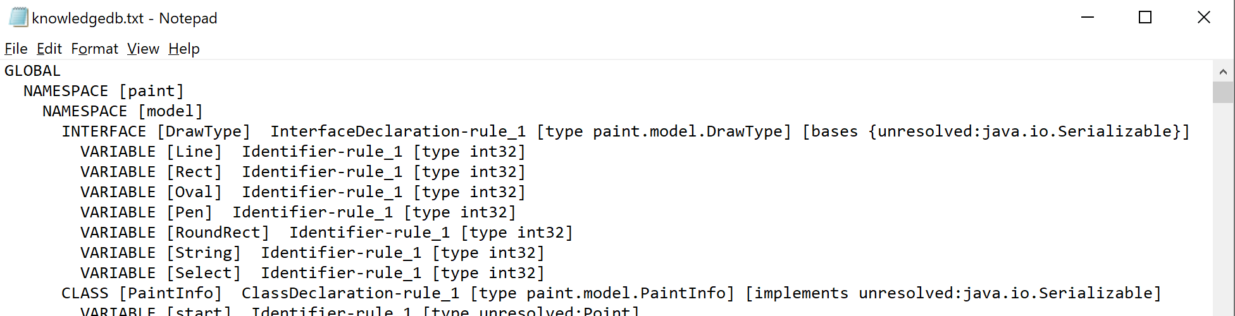
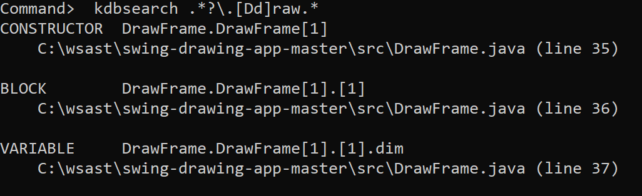
Search – Knowledge DB
Everything about the code is kept in the Knowledge DB, which is dumped into a text file in the project directory, but can also be searched in wSAST:
This is useful for finding interesting areas of code from specific regexes, such as auth, password, database, models etc.

Slide 31
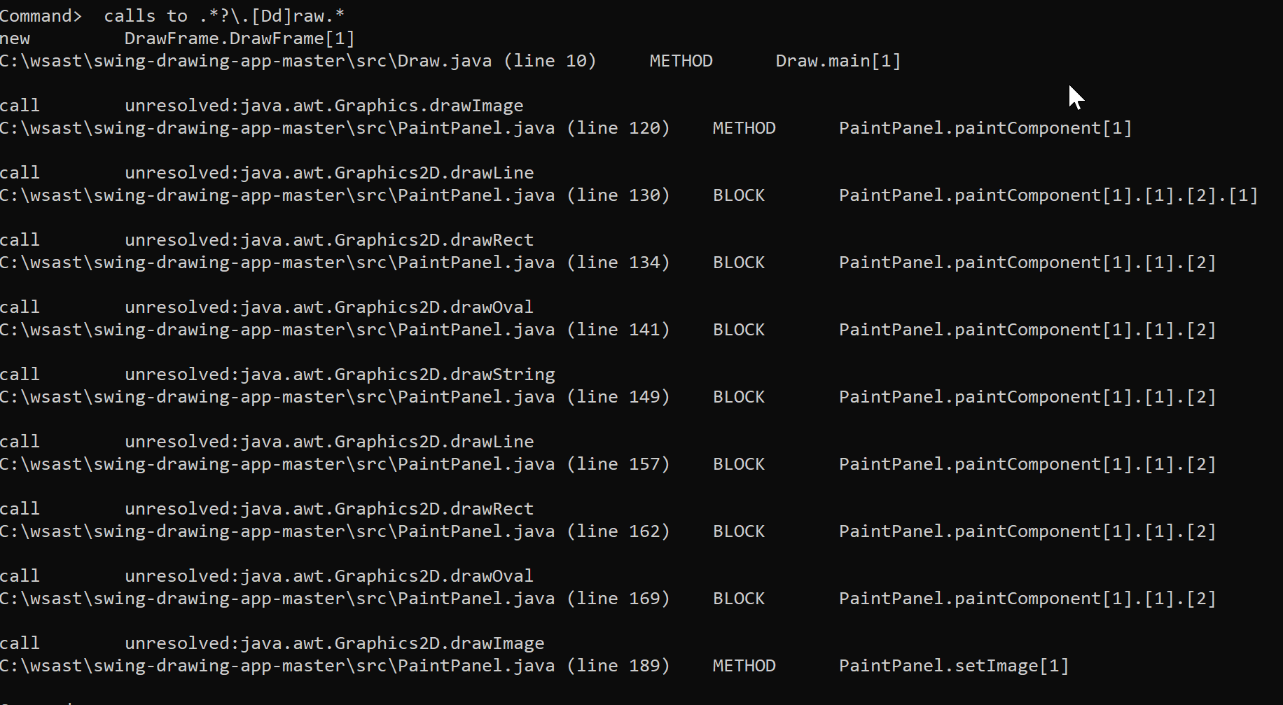
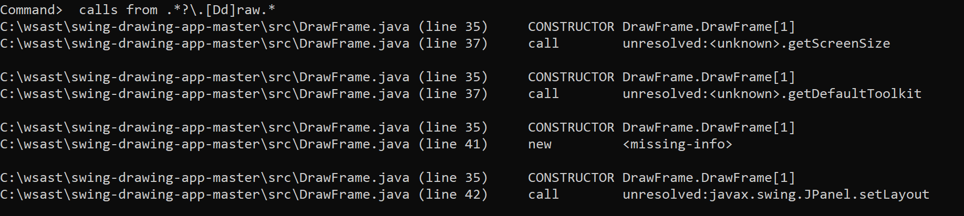
Search - Calls
Calls to and from methods with particular regex names can be generated in list form
This can be a useful way of finding references to functions of interest (and all the ways to reach them)

Slide 32
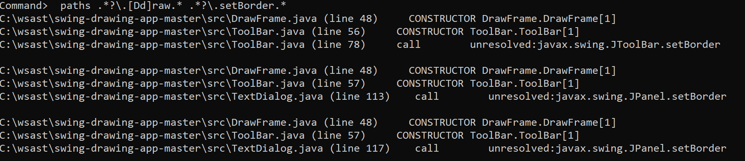
Search - Paths
Paths between functions (or sets of functions) can be graphed; just specify the start name regex and end name regex:
This can be useful to find paths between particular areas of the application such as request classes and auth or database methods

Slide 33
Usage – Dataflow Analysis (1)
Dataflow analysis is initiated using the “dfscan” command
Starting with each entrypoint (or based on provided filter), code flow is followed and each loaded source/sink is executed on each node encountered
Context on the state at point of execution is provided to the source/sink and the state of variables, associated tags, and matched sources and sinks can be read/updated
A sink can notify “subscribers” about any findings; subscribers can output findings into any format desired

Slide 34
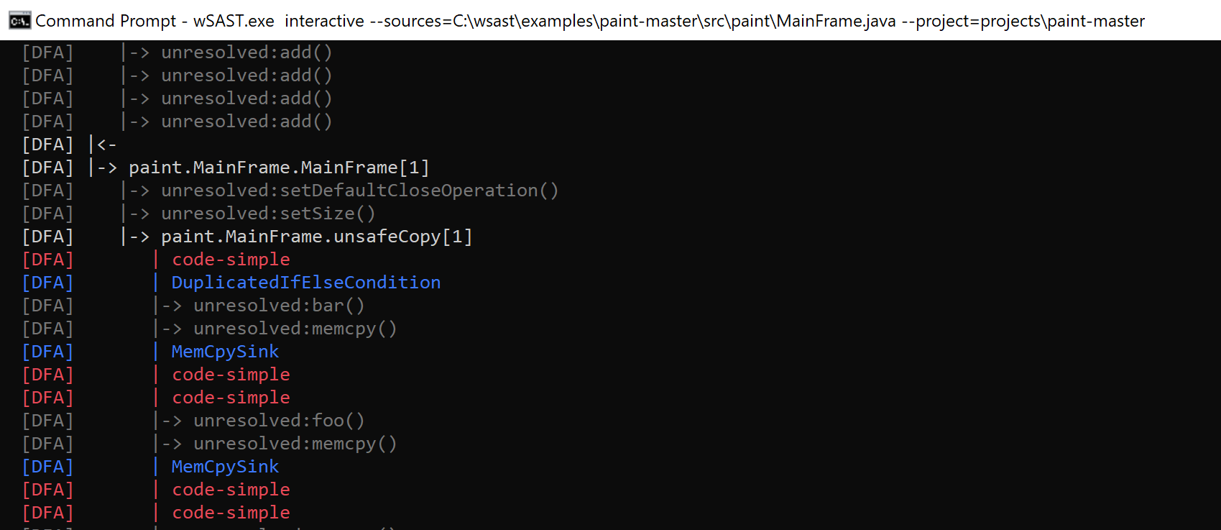
Usage – Dataflow Analysis (2)

Slide 35
Usage – Augmenting Analysis (1)
For cases where source code is missing (application, framework or runtime) it is possible to augment the code using WSIL
For example, if the source code for javax.servlet.http.HttpServletRequest is missing then dataflow tracing will not understand the types involved, for example that getParameter() returns a java.lang.String (or even that String is a “string type”)
WSIL augmentation allows code to flow naturally through missing types, and more bugs to be found; it is a write once use repeatedly scenario
This can also be used to link disparate code written in different languages together

Slide 36
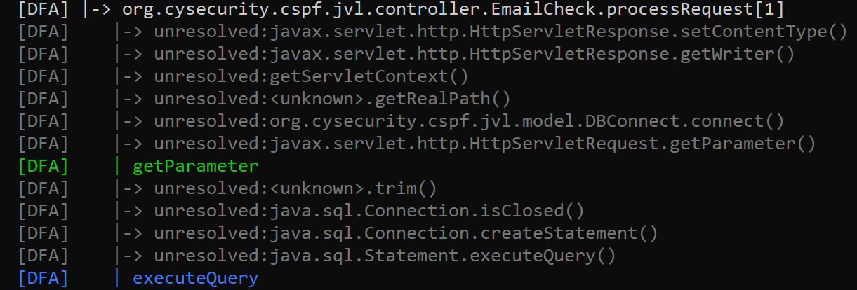
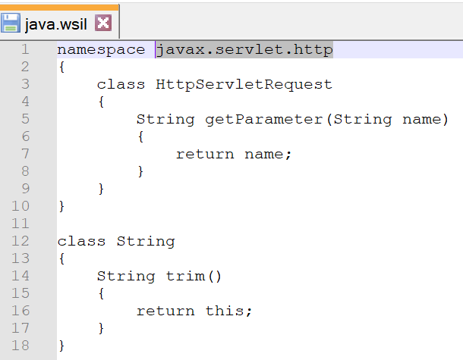
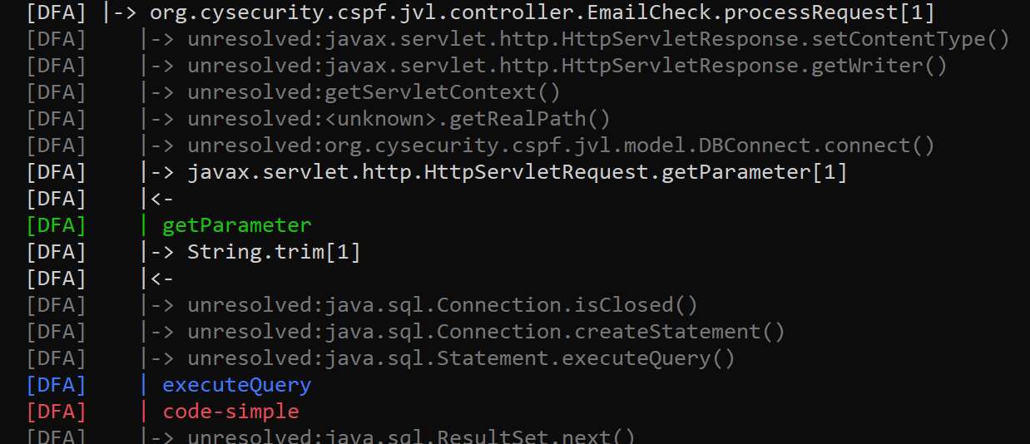
Usage – Augmenting Analysis (2)

Slide 37
Usage – Static Analysis (1)
Static analysis scans are initiated with the “sscan” command and validate the entire project WSIL AST for issues
They lack execution context but are great for quickly identifying bugs such as potential coding errors such as duplicated expressions, calls to unsafe functions (without parameter taint awareness), etc.
Since these scans execute very quickly and demand limited resources, it is often a good idea to run these first and review the results while the dataflow scan is being performed
Scans can result in a greater volume of false positives but the “traced-as-dynamic” config option helps

Slide 38
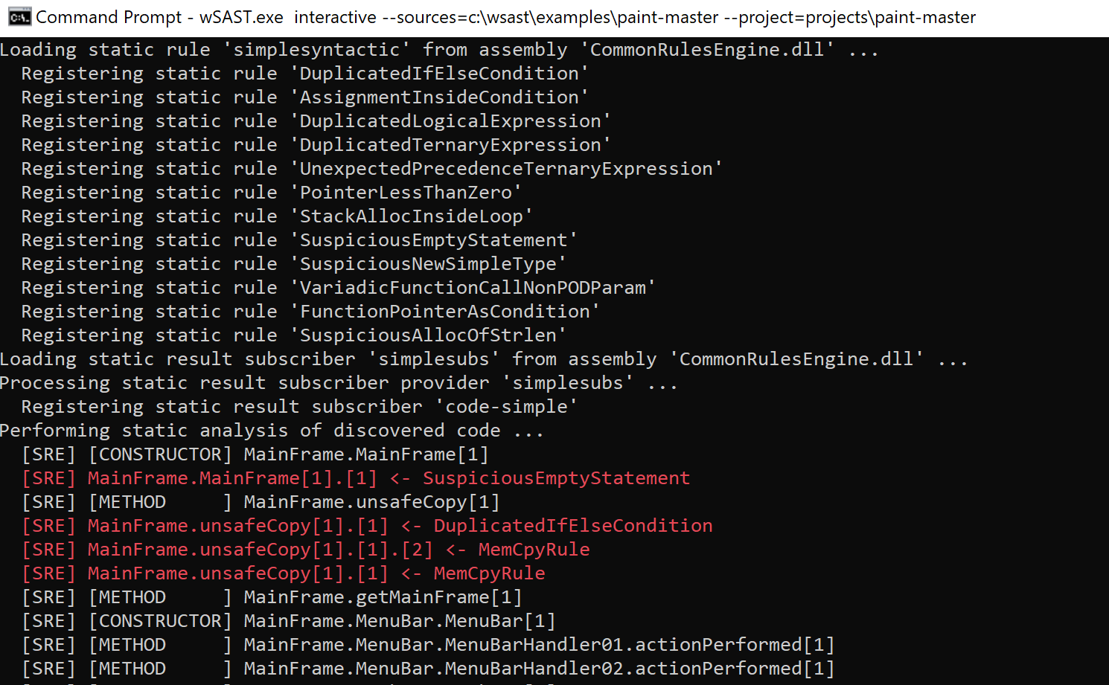
Usage – Static Analysis (2)

Slide 39
Output – Subscribers (1)
Outputs for dataflow scans are “subscribers” which implement a simple interface to receive results
Notifying subscribers is initiated by a sink and does not happen automatically (since some sinks are not supposed to report, just build context)
Lists of variables captured at the time of execution of matched sinks, paths, and issue descriptions are reported
Subscribers can output into any format desired; so far only a simple text output is currently provided

Slide 40
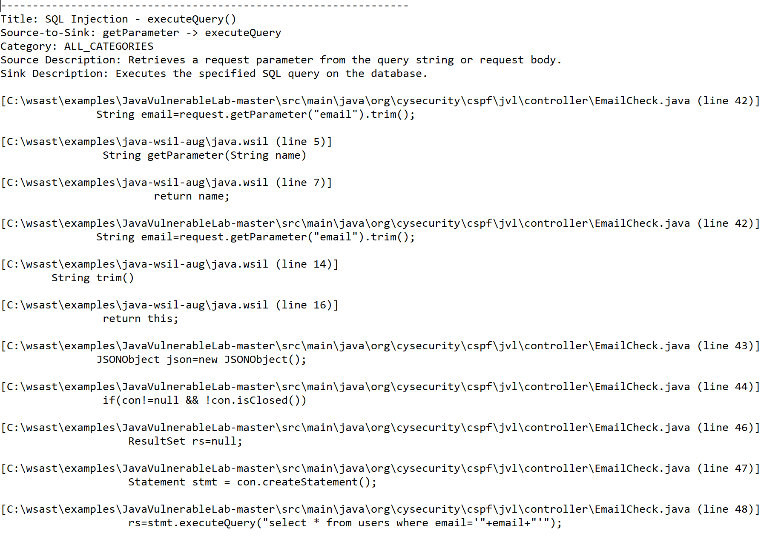
Output – Subscribers (2)

Slide 41
Common Rules Engine

Slide 42
Common Rules – Function (1)
wSAST comes with built-in support for simple function rules
These rules match a function call on several criteria:
Function/method name
Parameter types and count/return value type
Containing class or namespace
Virtual (if so walks the class hierarchy if known)
Additionally sink function rules can contain linked parameters, so a relationship between tainted parameters can be maintained and validated
Sources can mark parameter variables are traced; sinks can validate traced status

Slide 43
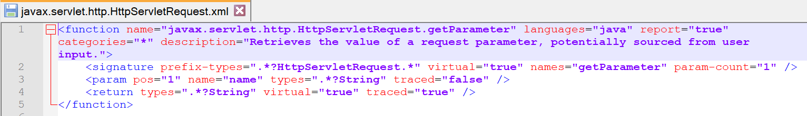
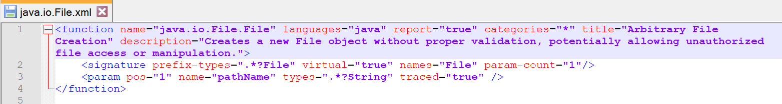
Common Rules – Function (2)

Slide 44
Common Rules – Variable (1)
wSAST comes with built-in support for simple variable rules
These rules can allow variables matching a specified regex to be marked as sources or sinks
The class or namespace containing the variable can also be validated against
So for example: any variable of any class where the class name contains “model”, or any variable of any class where the variable name contains “password”
The variable access can be specified (read or write, or both)
Typically sources would be read, sinks written
The variables can be marked as traced and detected by any sink

Slide 45
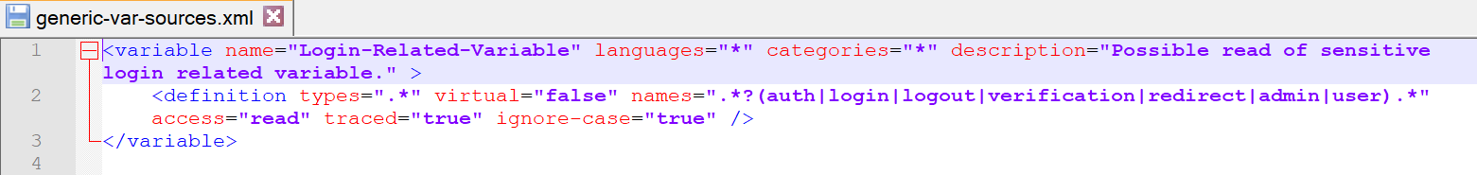
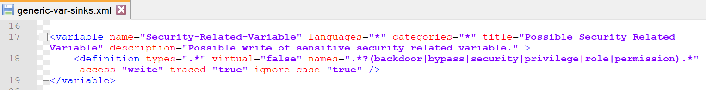
Common Rules – Variable (2)

Slide 46
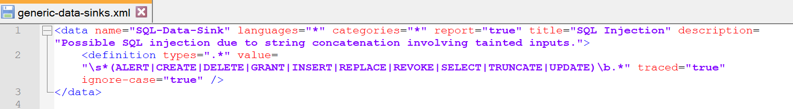
Common Rules - Data
wSAST comes with built-in support for simple data rules
Data rules can be used to match specific literal data fragments within the code as sources or sinks (generally data rules would only be sinks)
If the data fragment is matched and the input is traced a sink match occurs

Slide 47
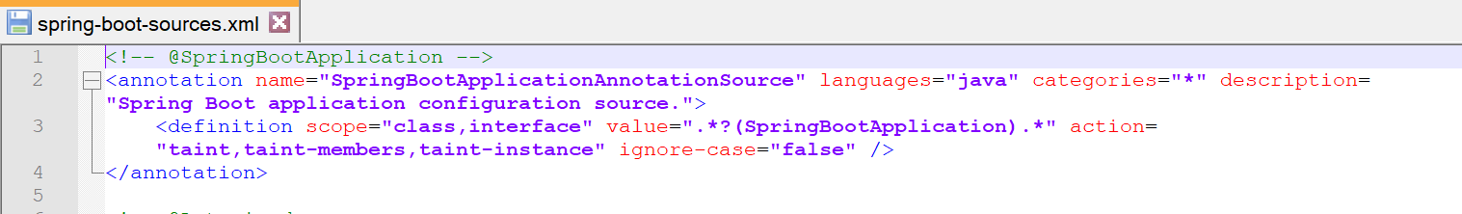
Common Rules – Annotation
wSAST comes with built-in support for simple annotation rules
Annotation rules can be used to match specific class, method, parameter, variable etc. annotations and mark the resulting variable, instance or data members as traced
The scope (code object) and action (what should be marked traced) of a matched annotation can be specified

Slide 48
Extending wSAST

Slide 49
Technical – Dataflow Source/Sink (1)
Sources and sinks can be provided by implementing a simple interface and adding entry to config XML; these are evaluated when the “dfscan” command is run
Both are executed once per node on the local CFG during dataflow analysis
Can attach and read arbitrary state to nodes, dataflow variables for extensibility
Full path from entrypoint can be examined,matches sources attached to variables and matches sinks for an ordered list (and can go out of scope if needed)

Slide 50
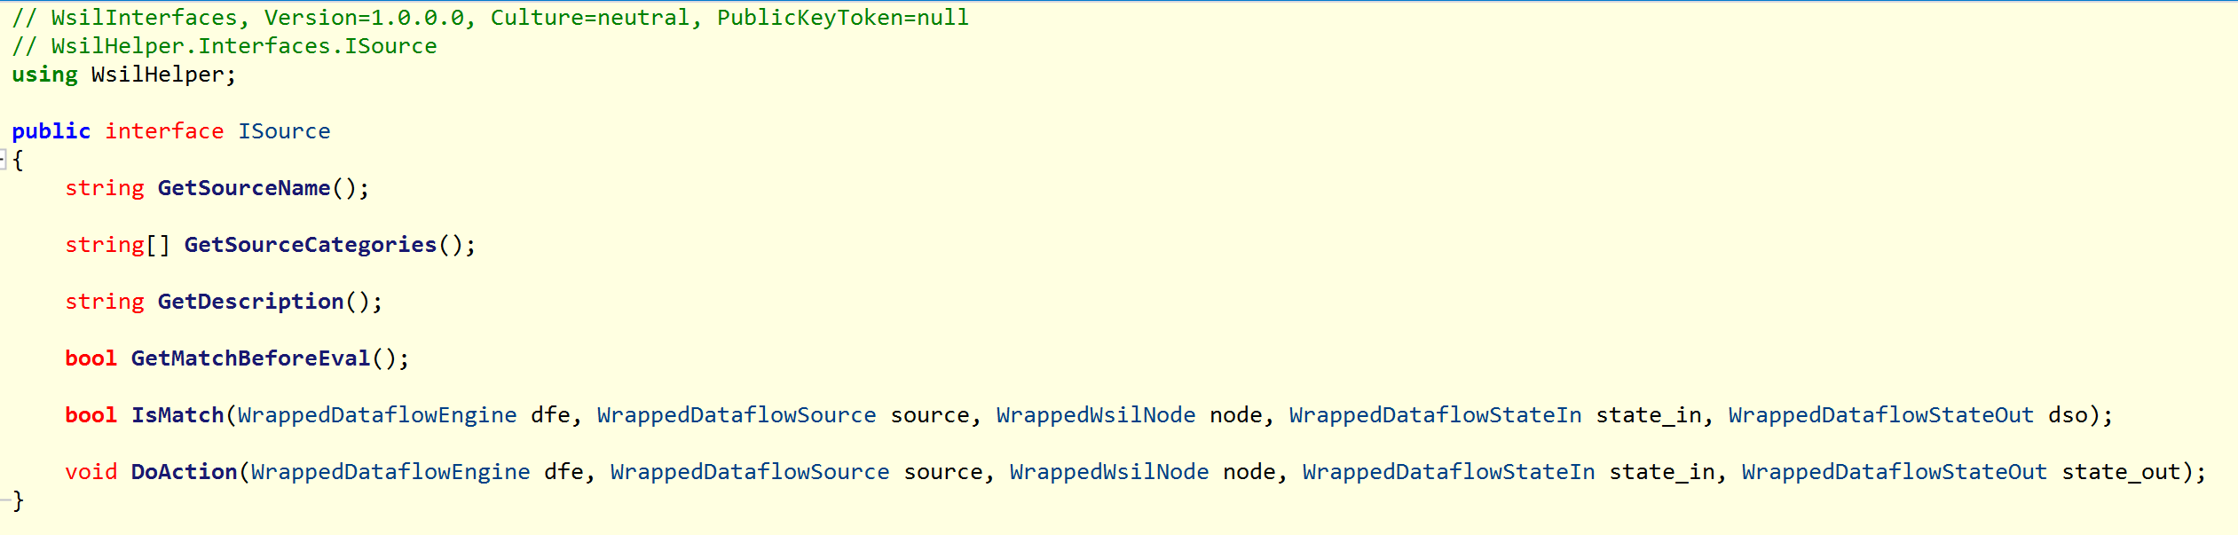
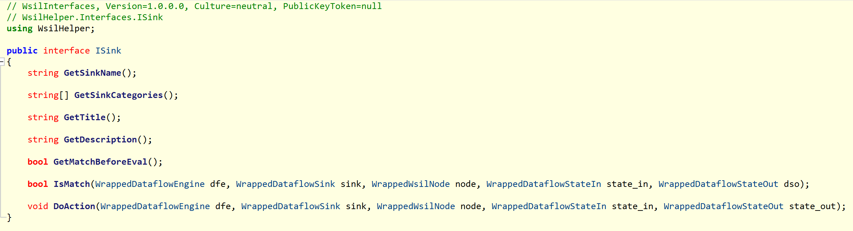
Technical – Dataflow Source/Sink (2)

Slide 51
Technical – Static Rules (1)
For WSIL AST-only rules another interface can be implemented; these rules are evaluated when the “sscan” command is run
These rules are executed without context (e.g. runtime state) and knowledge of variables, but can still be quite powerful as they can build up context internally
The static rules are much faster to execute and are good for finding problem areas of code for manual review

Slide 52
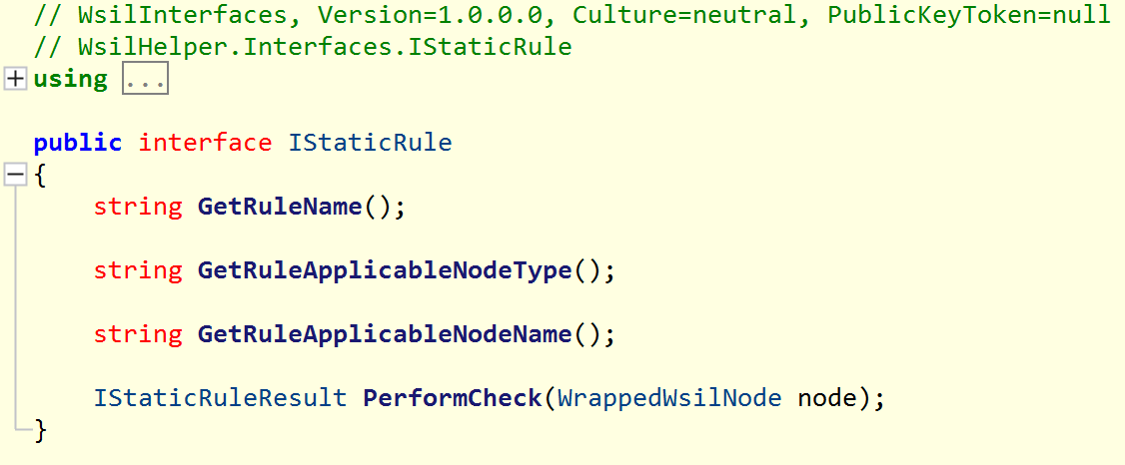
Technical – Static Rules (2)

Slide 53
Technical – Language Support (1)
Language support is extended by implementing a simple interface and adding entry to config XML
The language processor must parse the original language (e.g. Java) and then use WrappedWsilNodeBuilder class to build IL tree
Callbacks to notify the UI of progress

Slide 54
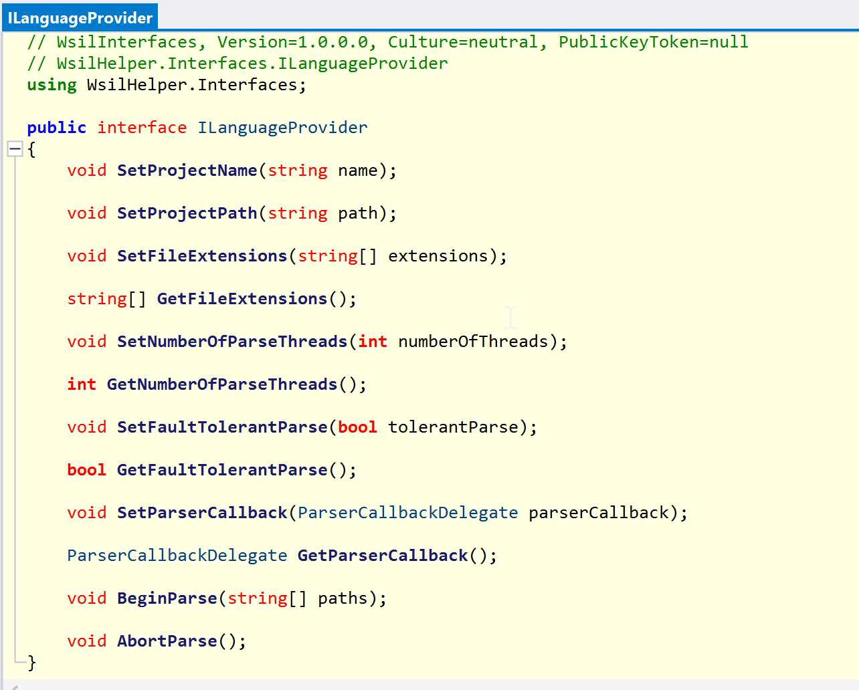
Technical – Language Support (2)

Slide 55
Future Plans
Short term – add many more Java rules (GPT is excellent for this); WSIL shims for common Java frameworks including web, RPC, mobile
Short/Mid term – add support for more CWE entries; common syntactical mistakes;
Mid/Long term – add parsers and translators for more languages; more language constructs
Long term – interactive IDE plugin (graphing, right click menu to create source/sink and initiate scan); paradigms for languages not yet supported (e.g. declarative, functional)

Slide 56
Demo
Wish me luck…

Slide 57

Questions?

Slide 58
Contact
Me
@peterwintrsmith on Twitter.
wSAST Product & Development
https://www.wsast.co.uk/
@wsastsupport on Twitter
support@wsast.co.uk for tech support by email.

